Slide 1
SEARCHING
Finding the location of a given data item in a collection of items.
It depends on the data structure used.
An array with n items can be searched using
  Linear search (sequential search)
  Binary search
    very fast and efficient
    This needs data to be sorted.

Slide 2
SEQUENTIAL SEARCH
Can be applied
  to array and LL
  to sorted as well as unsorted list
In sorted list :
Start searching sequentially from 0th location of the array, till either element is found or the element whose value is greater than the element being searched is found.

Slide 3
Sequential Search in Unsorted list
In unsorted list
sequentially search from the 0th location one after the other till the element is found or after reaching the (n-1)th location of the array.
Ex: Given an unsorted array
2 8 14 56 24 16 1 89 3
Search for 56
Result at step 5
Performance : no. of comparisons done to find out an element. O(n)

Slide 4
Sequential search in unsorted list
Write a program to read a set of n numbers, and search for a particular element item.
Main steps :
Read n, the size of the array
Read the n elements and store them in an array.
Read the search element, item
Using a loop, sequentially compare every array element with item
Print the location of the item, if it is found, else print element not found.

Slide 5
Searching in ordered list – Binary search
Needs elements to be sorted.
Compare search item with the mid element of the array. If found terminate successfully.
Divide the array into two parts
First part from 0 to (n/2 -1) – elements lower than the mid element.
Second part from (n/2 + 1) – elements greater than the mid element.
Compare the element with mid element. If same, return location, else next step
Searching is continued either with first part(if search item is smaller than mid) or second part(if search item is greater than mid) .

Slide 6
Binary Search
Process is repeated for first or second half, until element is found, or the division gives one element.
If list is unsorted
  linear search
  Binary search after sorting.
If list is sorted
  binary search

Slide 7
Binary Search
Pseudo code :
low = 1, high = n
while(low<high)
{ mid = (low + high)/2
if (item = a[mid])
{ print element found at location mid and
stop}
else if (item < a[mid]) high = mid - 1;
else low = mid + 1;
}
3. Print location is zero and element is not found, if for all iterations item = a[mid] is false.

Slide 8
Binary Search
Ex : Search for x = 25 in the sorted list:
23 26 41 52 59 75 84 91
S.No | Low | High | Mid | a[mid] | x = a[mid] or x < a[mid] or x > a[mid]

Slide 9
Analysis of sequential and binary search
Sequential search in unsorted/sorted array:
Best case: if search element is at first position
  No. of comparisons is only one.
Average case: element not in fast or last position.
  No. of comparisons = average number of comparisons
Worst case: search element is in last position
  No. of comparisons = n

Slide 10
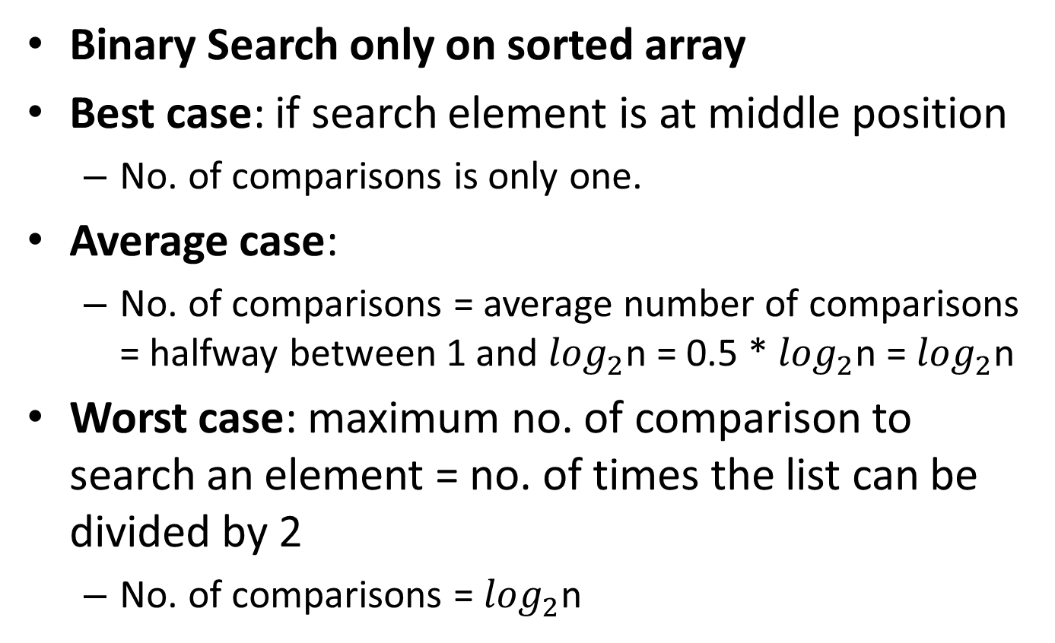
Analysis….
Binary Search only on sorted array
Best case: if search element is at middle position
  No. of comparisons is only one.
Average case:
  No. of comparisons = average number of comparisons = halfway between 1 and $\log_{2}^{}$n = 0.5 * $\log_{2}^{}$n = $\log_{2}^{}$n
Worst case: maximum no. of comparison to search an element = no. of times the list can be divided by 2
  No. of comparisons = $\log_{2}^{}$n

Slide 11
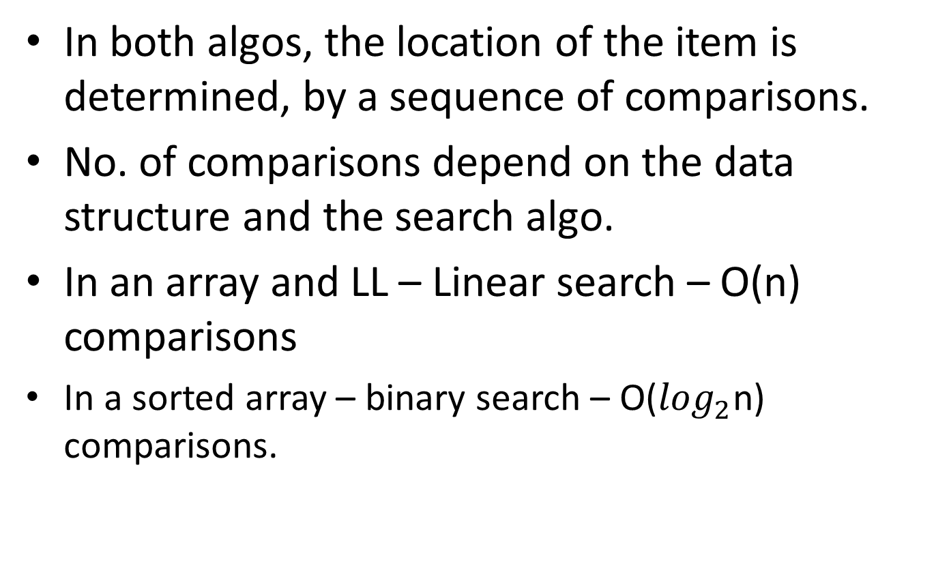
Searching on Random Access Lists
In both algos, the location of the item is determined, by a sequence of comparisons.
No. of comparisons depend on the data structure and the search algo.
In an array and LL – Linear search – O(n) comparisons
  In a sorted array – binary search – O($\log_{2}^{}$n) comparisons.

Slide 12
Hash Table
  Some applications require search to be performed in constant time – O(1). Ideally impossible – but very close to it is possible.
  Uses a data structure – hash table
  Ordinary array – direct addressing.
  An element 10 is stored in a[10]
  Advantage: search in O(1)
  Disadvantages:
  If the actual no. of keys is very small as compared to the total no. of possible keys, lot of space in the hash table will be wasted.
  Ex: hash table a[100] Possible keys : 1 to 100.
  Actual keys : 12, 15, 30, 45

